Slide 1
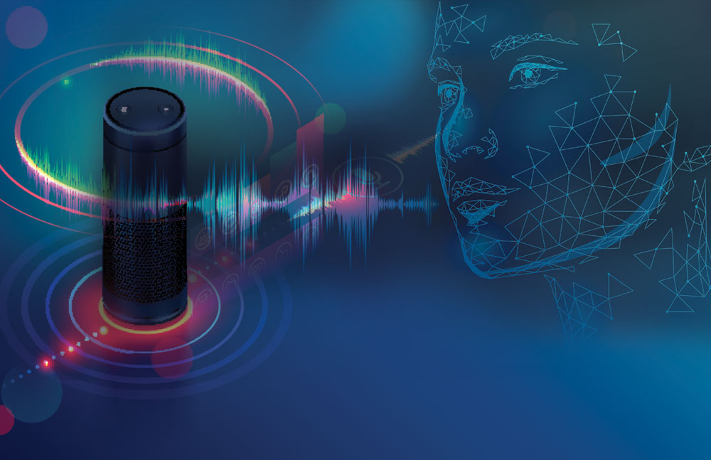
AUDIO
PREPROCESSING

Slide 2

TEAM MEMBERS:
Vijay Karthik
Srinadh
Alekhya
Sampath
Sathya
Rakesh
Sai Kiran
3

Slide 3

AUDIO PREPROCESSING
USING
SINGLULAR VALUE DEOMPOSITION(SVD)
Audio preprocessing plays a crucial role in numerous audio applications, such as speech recognition, music analysis, noise reduction, and audio classification.
The quality of input audio significantly affects the accuracy and performance of these applications.
Preprocessing techniques help in removing noise, normalizing amplitudes, reducing dimensionality, and enhancing the overall audio quality.

Slide 4



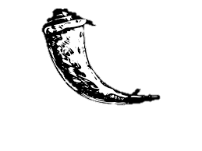
TECHNOLOGIES USED:
HTML and CSS are the front end languages we used.
2) HTML is for frontend for creating a basic forms and CSS is for styling our web page
3) We used python for backend and an unsupervised learning algorithm to make our Audio pre processing project using singular value decomposition
4) Flask is a open source web framework used for connecting front end and backend
PYTHON
CSS
FLASK

Slide 5

SINGULAR VALUE DECOMPOSITION (SVD)
Singular Value Decomposition (SVD) is a fundamental matrix factorization technique.
It decomposes a matrix into three separate matrices: U, Σ, and V.
U and V are orthogonal matrices, while Σ is a diagonal matrix containing singular values.
SVD is widely used in various fields, including audio signal processing, due to its ability to reveal important patterns and structures within data.

Slide 6

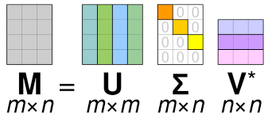
FORMULA
A = UΣV^T
A is the original matrix of size m x n.
U is an m x m orthogonal matrix. The columns of U are called left singular vectors.
Σ is an m x n diagonal matrix with non-negative entries, often referred to as singular values.
V^T is the transpose of an n x n orthogonal matrix V. The columns of V^T are called right singular vectors.

Slide 7

STEPS FOR AUDIO PREPROCESSING USING SVD
Convert the audio signal into a matrix representation.
1
Apply SVD to decompose the audio matrix into U, Σ, and V.
2
Analyze the singular values to determine the significant components and noise levels.
3
Select a threshold to retain the most important singular values and discard the remaining.
4
Reconstruct the audio matrix using the retained singular values and inverse SVD.
5
Obtain the preprocessed audio signal by converting the matrix back into an audio format.
6

Slide 8
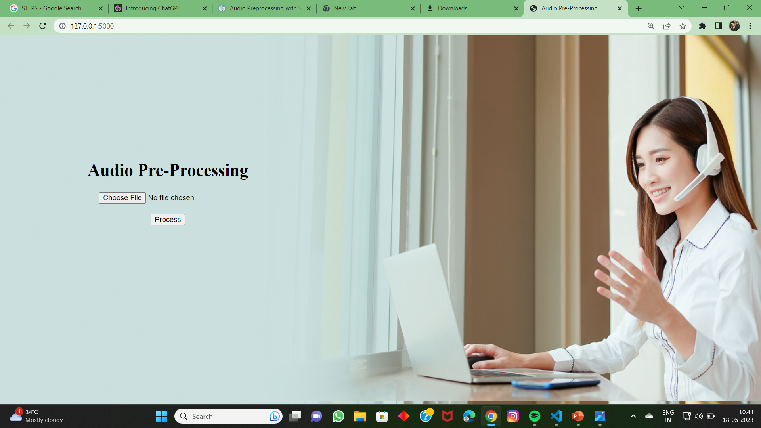
USER INTERFACE

Slide 9


BENEFITS OF AUDIO PREPROCESSING USING SVD
Noise reduction: SVD helps identify and remove unwanted noise components.
Dimensionality reduction: By retaining only significant singular values, the audio data can be represented in a lower-dimensional space.
Feature extraction: SVD reveals important patterns and structures in the audio signal.
Improved audio quality: Preprocessing using SVD enhances the overall audio fidelity.

Slide 10


CONCLUSION
By leveraging the capabilities of SVD, we can achieve improved audio quality and more accurate results in audio processing tasks.

Slide 11


